Slide 1
PERCEPTRON : McCulloch and Pitt’s Model Proposed in 1943
SINGLE LAYER NN- the most basic version of an artificial neuron
Made of a summing element and a threshold function
Output of the perceptron, is always boolean[ 0/1, 1/-1] ,Binary Classifiers
Input could be Boolean/real number

Slide 2
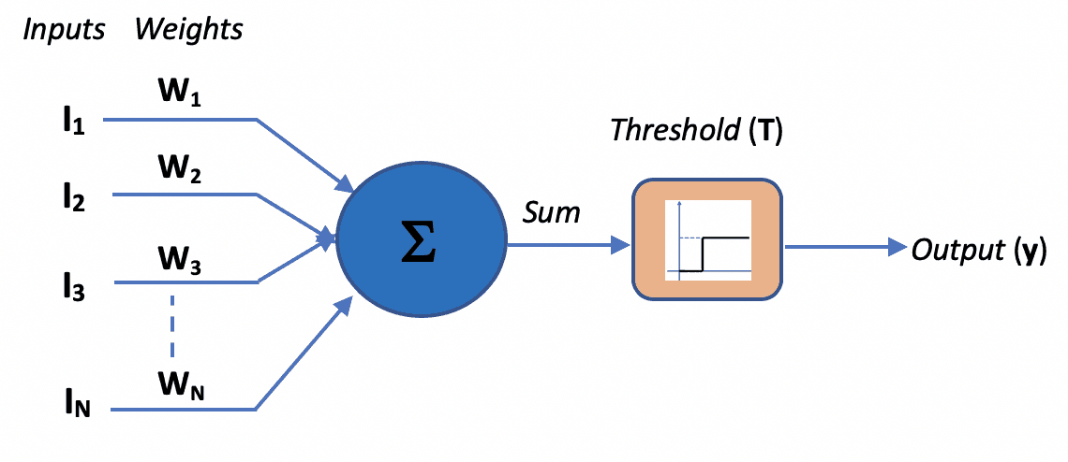
PERCEPTRON : McCulloch and Pitt’s Model

Slide 3
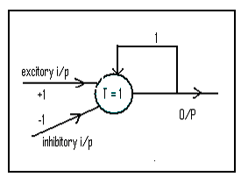
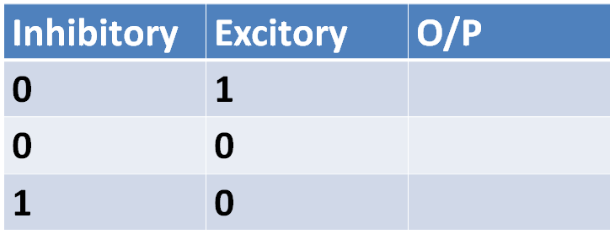

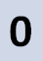
Fill the Truth Table, Identify the function
Assume initially O/P = 0.
LATCH

Slide 4
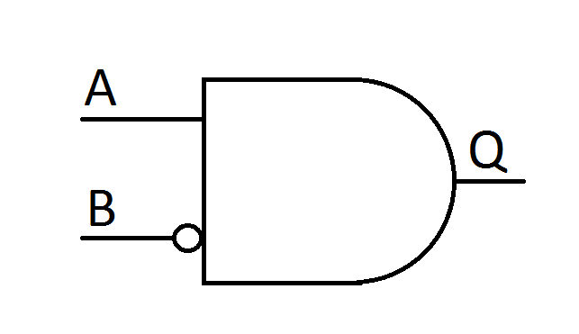
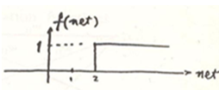
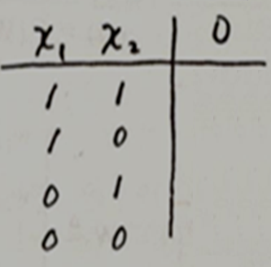
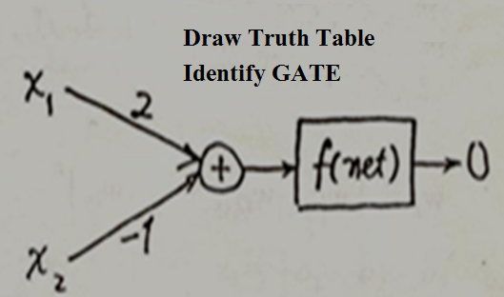
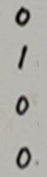
A AND-NOT B gate calculates the function ‘A AND NOT B’.
LINEARLY SEPARABLE

Slide 5
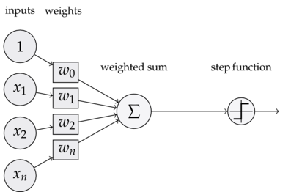
The single layer perceptron is a supervised learning algorithm that only works on linearly separable data
Making a Perceptron Learn involves arriving at the weights w₀, w₁,…, w_{n}.

Slide 6
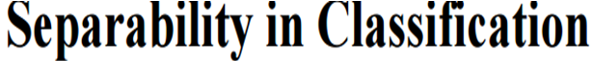
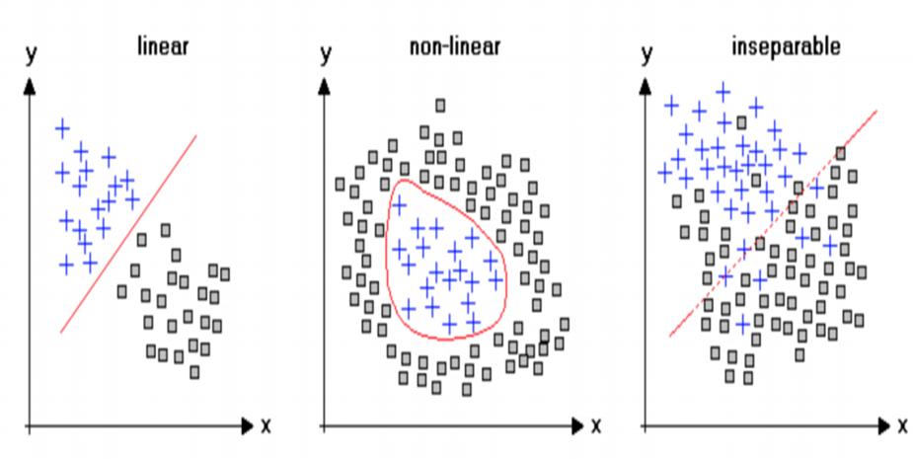

Slide 7
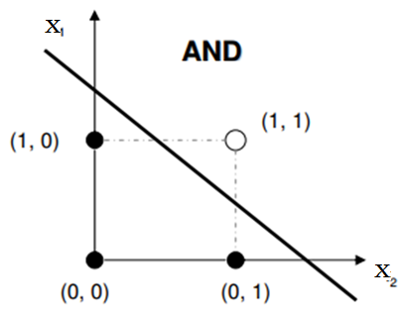
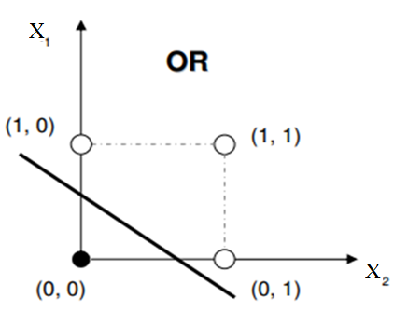
there are many such lines, and any such line gives a solution.
What is the equation of the line separating two classes?

Slide 8
y(0,0) = 0 ⇒ f(b) = 0 ⇒ b <0, 0 is threshold
y(0,1) = 1 ⇒ f( w₂ x₂ +b) = 1 i.e.
w ₂x₂ +b ≥ 0, i.e. w₂ +b ≥ 0, i.e. w₂ ≥ -b
y(1,0) = 1 ⇒ f( w₁ x₁ +b) = 1, i.e.
w₁ x₁ +b ≥ 0, i.e. w₁ +b ≥ 0, i.e. w₁ ≥ -b
y(1,1) =1 ⇒ f( w₁ x₁ +w₂ x₂ +b) = 1 , i.e.
w₁ x₁ +w₂ x₂ +b ≥ 0,
w₁ +w₂ +b ≥ 0, i.e. w₁ + w₂ ≥ -b
Choose any numbers for w₁ ,w₂ , and b satisfying these inequalities.
One solution is w₁ = w₂ = 2, b = -2.

Slide 9
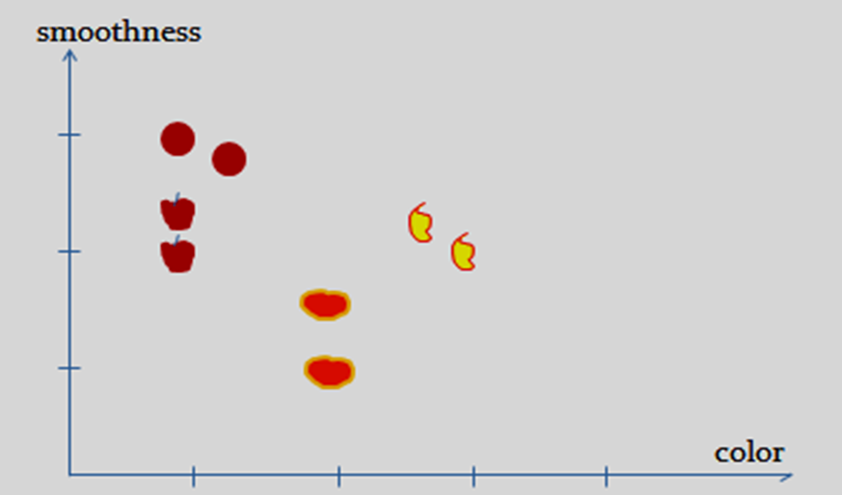
Check the feasibility of using single layer single neuron Perceptron for recognition of patterns
two discriminatory features <color, texture> for automatic fruit recognition.

Slide 10
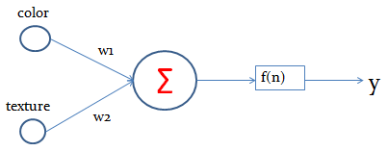
Color | Texture | Fruit (supervised learning)
1 | 2 | Apple
3 | 2 | Mango
2 | 1 | Orange
1 | 3 | Plum
1.4 | 2.8 | plum
2 | 1.5 | orange
2.5 | 2.2 | mango
1 | 2.2 | apple

Slide 11
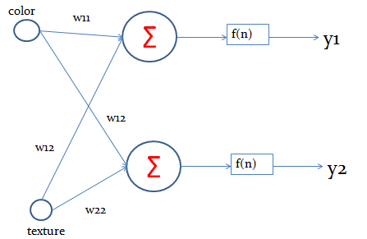
single layer two neuron Perceptron
y1 = 0 , y2 = 0 represents that the test input is Apple
y1 = 1 , y2 = 0 represents that the test input is Orange
y1 = 1 , y2 = 0 represents that the test input is Mango
y1 = 1 , y2 = 1 represents that the test input is Plum

Slide 12
single layer four neuron Perceptron
The expected output can also be modeled as a 4 tuple as
<1,0,0,0> for apple
<0,1,0,0> for Orange
<0,0,1,0> for Mango
<0,0,0,1> for plum

Slide 13
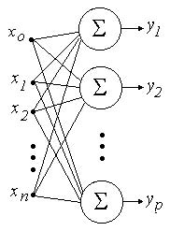
Single- layer neural network or perceptron:
Single layer Neural Networks can only learn solutions to problems that are linearly separable

Slide 14
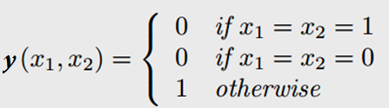
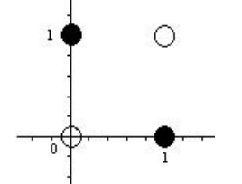
Exclusive or(XOR) is the Boolean function with truth table:
When we display the input-output relationship expressed by g, we see that this problem is not linearly separable, i.e. there is no line that can separate the two subsets
Therefore, the function y cannot be implemented by using a single perceptron, so we need to consider a hidden layer.

Slide 15
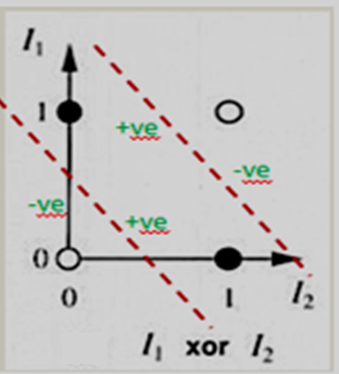
we need two straight lines, not possible with single layer single neuron, so will have to go for more layers.

Slide 16
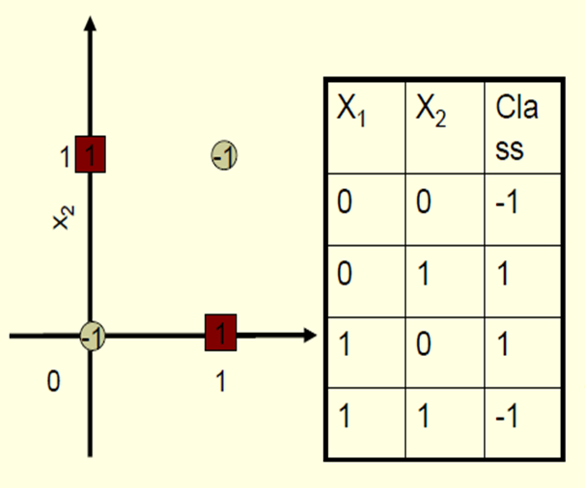
XOR- BINARY INPUT, BIPOLAR OUTPUT

Slide 17
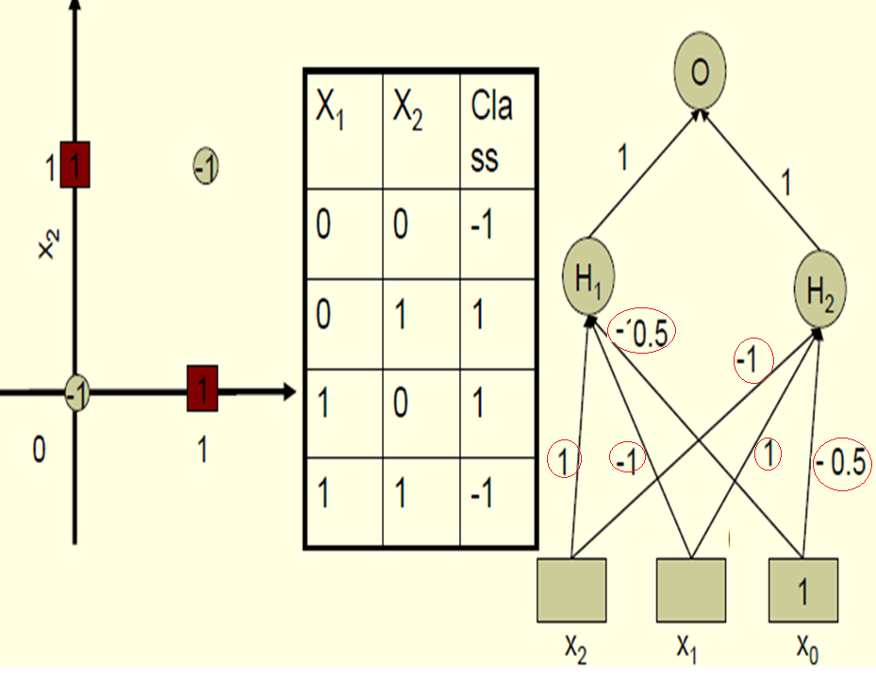
Bipolar Activation function with o/p as 1,-1 with threshold 0

Slide 18
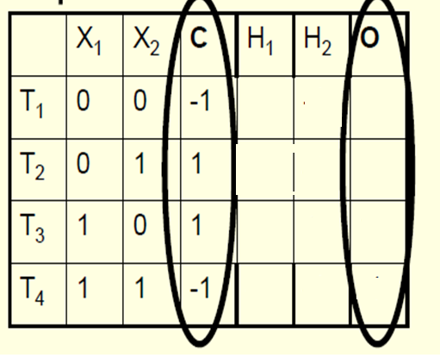
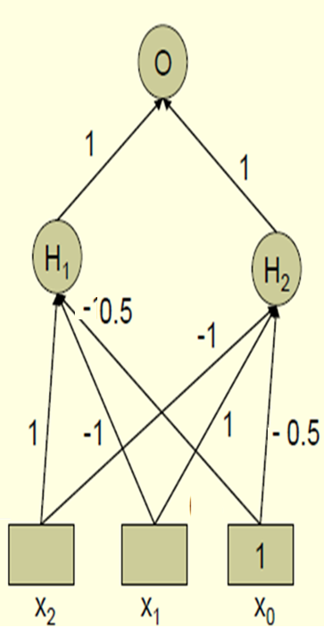
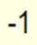
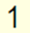
Fill the entries: output of H₁ and H₂ and O
Bipolar Activation function with threshold 0

Slide 19
Find output of H₁ and H₂ and O
Bipolar Activation function with threshold 0
X₁ =0 , X₂ = 0
H_{1-in} = (-1)(X₁=0)+(1)(X₂=0)+(b=-0.5)(1)
=-0.5
H_{1-out} = -1
H_{2-in} = (1)(X₁=0)+(-1)(X₂=0)+(b=-0.5)(1) b
=-0.5
H_{2-out} = -1
O_{in} = (1)H_{1-out} +(1)H_{2-out}
= -1-1= -2
O_{out} = -1
_{Similarly for other inputs}

Slide 20
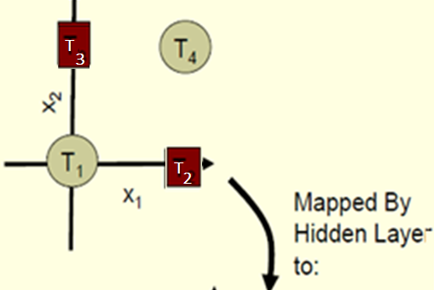
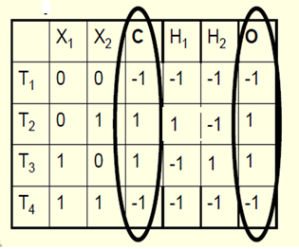
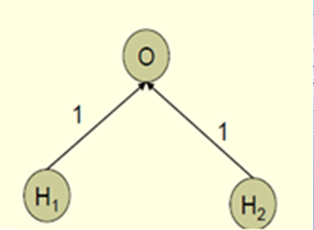
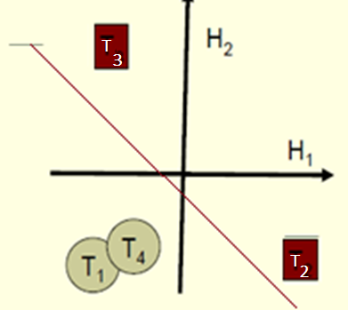
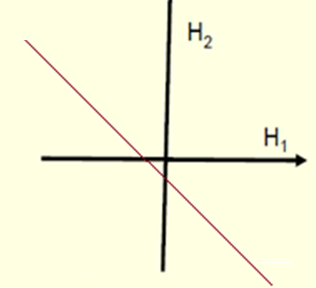
Put T₁ T₂ T₃ T₄ on H₁ H₂ plane

Slide 21
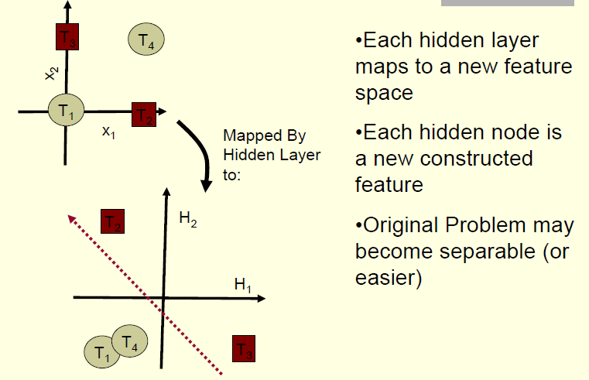
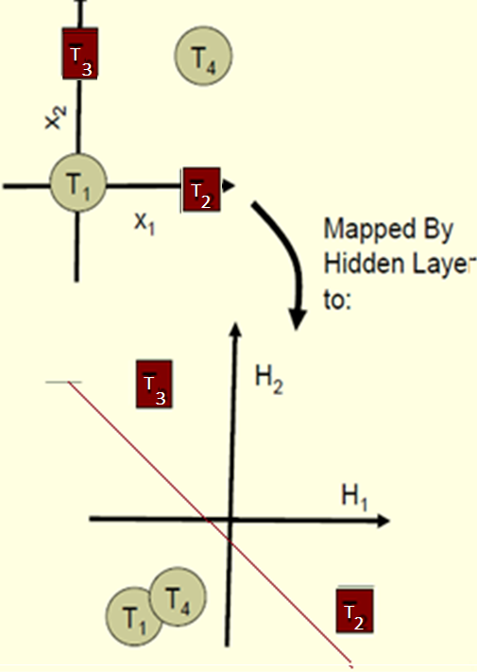

Slide 22
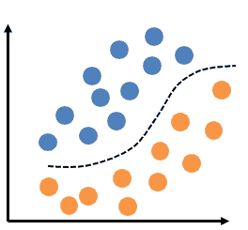
A perceptron with single layer of weights can only help in linear or binary data classifications.
If the input data is not linearly separable, MLP(multilayer perceptron) model is used

Slide 23
Multi-layer Networks and Perceptrons
- Have one or more layers of hidden units.
- With one/two possibly very large hidden layers, it is possible to implement any function.
- Networks without hidden layer are called Perceptrons.
- Perceptrons are very limited in what they can represent, but this makes their learning problem much simpler.

Slide 24
MLP "perceptrons" are Not PERCEPTRONS in the strictest possible sense.
True perceptrons are a special case of artificial neurons that use a threshold activation function
MLP perceptrons/neurons can employ arbitrary activation functions.
True perceptron performs binary classification
an MLP neuron is free to either perform classification or regression, depending upon its activation function.

Slide 25
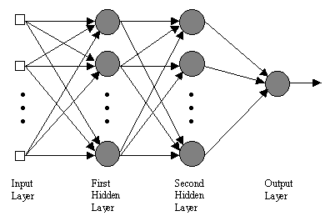
THE MULTILAYER PERCEPTRON

Slide 26
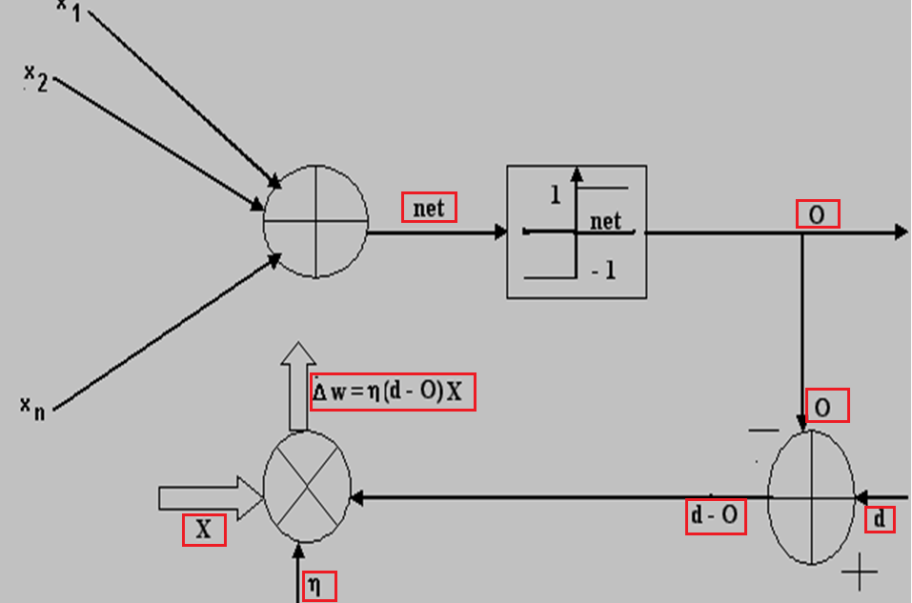
Perceptron Learning Rule

Slide 27
Perceptron Learning Algorithm
Weights are set randomly initially
For each training example
Calculate the observed output (O) from the ANN,
If the target output(t) is different from observed output
Then tweak all the weights by PERCEPTRON TRAINING RULE
This is done for every example[ showing all examples completes one EPOCH]

Slide 28
if error criterion is not satisfied
Repeat the cycle again (an ‘epoch’)
Until the ANN produces the correct output[within acceptable limits] for all the examples in the training set
algorithm will converge within finite number of iterations
If training data is linearly separable
and η sufficiently small.
If the data is not linearly separable, convergence is not assured.

Slide 29
PERCEPTRON TRAINING RULE
Δw_{i} = η(d – o) x_{i}
w_{i} ← w_{i} + Δw_{i}
d/t is desired/target output value for the current training example
o is perceptron output
η is small constant (e.g., 0.1) called learning rate [Hyperparameter]

Slide 30
Hyperparameters are set before training(before optimizing the weights and bias).
Hyper-parameters are “higher-level” parameters that describe structural information about a model that must be decided before fitting model parameters
examples of hyper-parameters
Learning rate , Regularization factor
Momentum rate.
Size of network, batch size, number of epochs

Slide 31
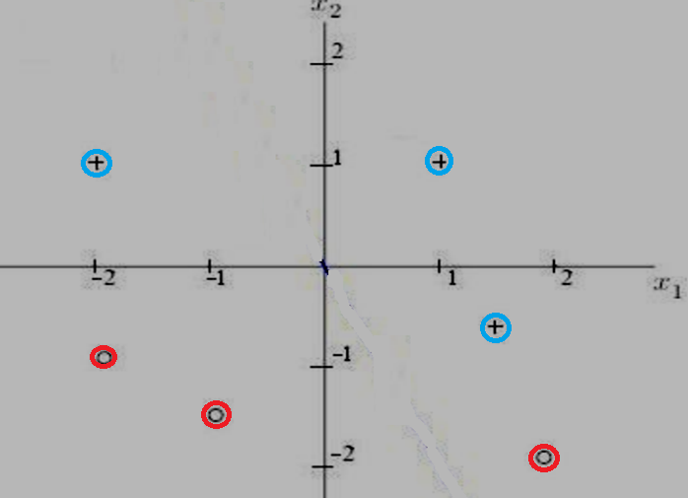
“+” points to one side of line, target output =1,
“0” points to other side of line, target output=0
P1 (1,1), t=1
P2(2,-2),t=0
P3(-1,-1.5),t=0
P4(-2,-1),t=0
P5(-2,1),t=1
P6(1.5,-.5),t=1
Use Perceptron learning to separate SIX points in two classes.
Activation Fuction :
unipolar step (0/1),Threshold value is Zero.

Slide 32
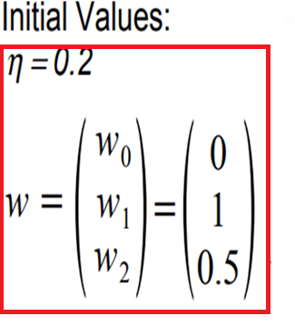
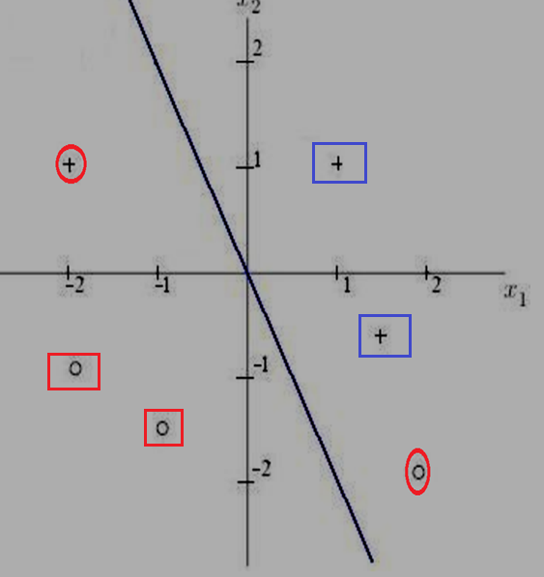
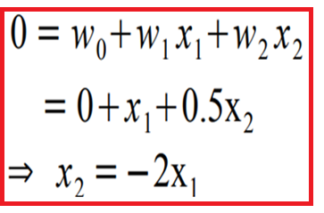
Equation of separating line :
w₁ x₁ +w₂ x₂ +w₀(=b) =T
T is threshold
One”+” point and one “o” point is misclassified with initial set of weights and biases

Slide 33
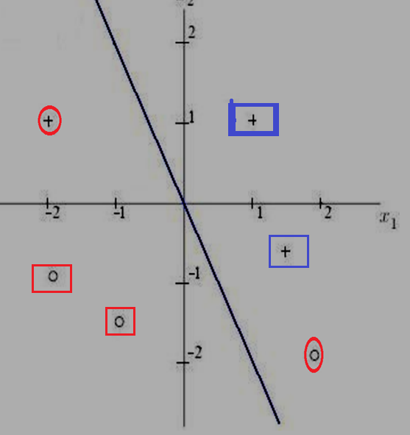
P1(1,1), t=1; bias(b =w₀=0, x₀=1)
o/p, y= f(bx₀+ w₁x₁ +w₂x₂) = f(0*1+1*1+0.5*1) = f(1.5) =1,
correct classification NO CHANGE in weights/biases

Slide 34
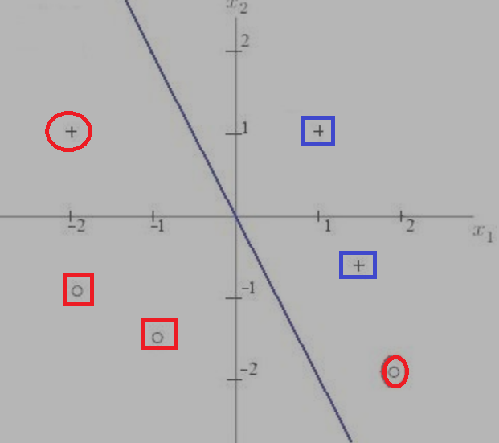
P2(2,-2), t=0
INCORRECT CLASSIFICATION

Slide 35
P2(2,-2) , x₁= 2, x₂ = -2, t=0
bias(b= w₀ = 0, x₀= 1) , w₁ = 1, w₂ = 0.5
Output :y = f(bx₀+ w₁x₁ +w₂x₂)= f( 0*1+1*2+0.5*-2)
= f(1.0) = 1; but t=0
INCORRECT CLASSIFICATION,
so change weights/bias,
Δw = η(t - 0)X = 0.2(0 -1)X = -0.2X;
w_{new} =w_{old} -0.2X

Slide 37
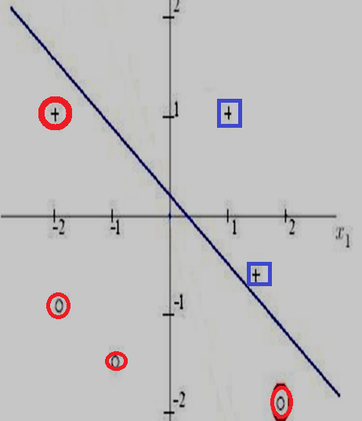
Separating line with changed weights and bias
Separating line with initial weights and bias

Slide 38
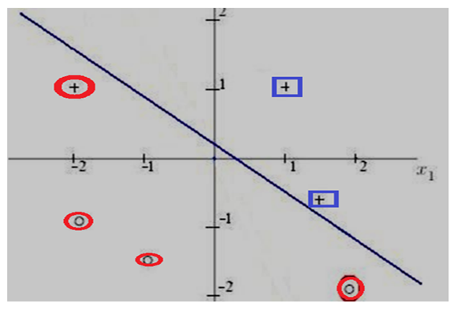
P3(-1,-1.5) , t=0, x₁= -1, x₂ = -1.5, b = -0.2, w₁ = 0.6, w₂ = 0.9
Output = y = f(bx₀+ w₁x₁ +w₂x₂)
= f( -0.2*1+0.6*(-1)+0.9*(-1.5)=f(-2.15)=0
t=“0” CORRECT CLASSIFICATION, so NO change in weights/biases

Slide 39
P4(-2,-1) , t=0, x₁= -2, x₂ = -1, b = -0.2, w₁ = 0.6, w₂ = 0.9
Output= y= f( -0.2*(1)+0.6*(-2) +0.9*(-1) )=f(-2.3)=0 =t
CORRECT CLASSIFICATION, so NO change in weights/biases

Slide 40
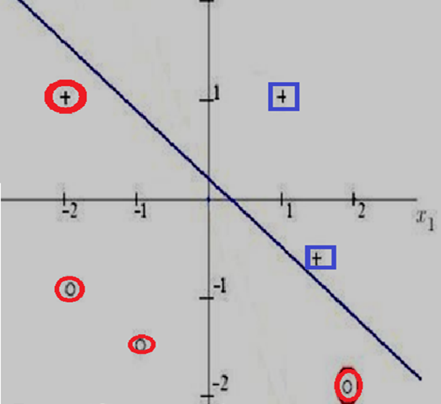
P5(-2,1), t=1, x₁= -2, x₂ = 1, b = -0.2, w₁ = 0.6, w₂ = 0.9
Output: y = f( -0.2(1)+0.6(-2)+0.9(1) ) = f(-0.5) = 0
Target=“1” for”+” INCORRECT CLASSIFICATION, so change in weights/biases

Slide 42
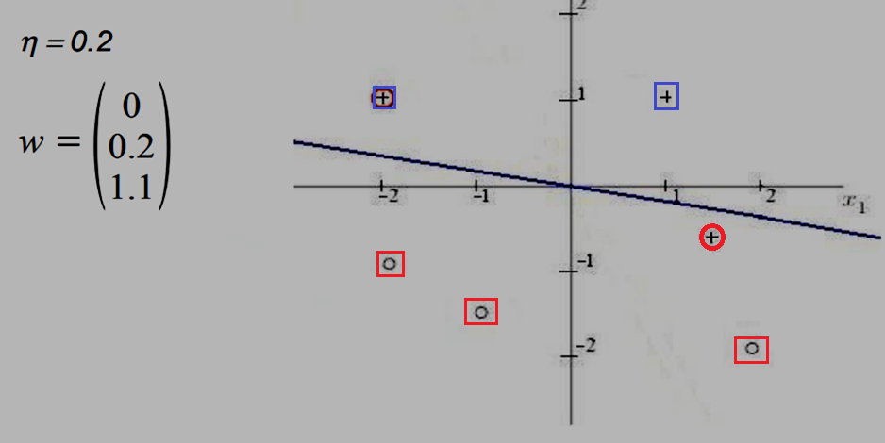

Slide 43
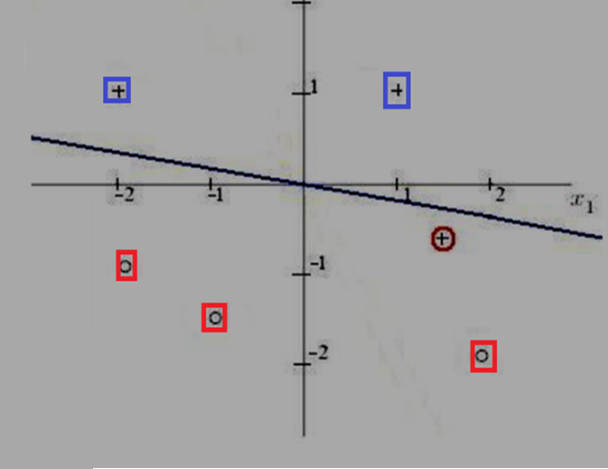
P6(1.5,-0.5) t=1, x₁= 1.5, x₂ =-0.5, b =0, w₁ = 0.2, w₂ = 1.1
Output: y= f( 0(1)+0.2(1.5) +1.1(-0.5))=f(-0.2)=0
Output should be “1” for”+”) INCORRECT CLASSIFICATION, so change in weights/biases

Slide 45
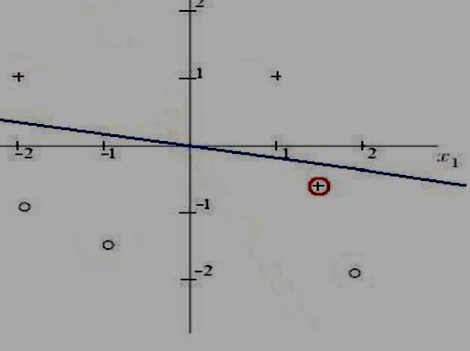
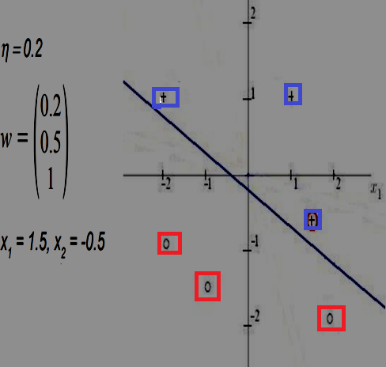
CORRECT CLASSIFICATION AFTER SIXTH POINT IS GIVEN

Slide 46
Fundamentals of Neural Networks,
by
Laurene Fausett

Slide 47


x₁ | x₂ | y
1 | 1 | 1
1 | 0 | -1
0 | 1 | -1
0 | 0 | -1
A Perceptron for the AND function:
Binary inputs ( 0/1)
Bipolar targets ( ±1)
Initial weights and bias equal to 0,
threshold = ±0.2 = θ
Learning rate =1

Slide 48


Slide 49


Rule Given
This Perceptron learning rule is
initial weight matrix could be zero or random

Slide 50
Δw_{i} = ηt x_{i} ; if (t – o) is not zero,
Δw_{i} = 0 if (t-o)=0
Target ‘t’/output ‘o’ are either 1 or -1 not 0,1 ,
Why ??
There will be no change if target is 0

Slide 51





Presenting the first input (1,1)
η=1
O NE t so change weights
Based on new weight [1, 1, 1(=b) ] and
input (x₁ ,x₂ ,1 ),
output = w₁x₁+ w₂x₂ + b
= x₁+ x₂+ 1
Write and Draw Equations for separating lines

Slide 52


x₁ | x₂ | y &f(net), net =x₁ + x₂ +1
1 | 1 | t = 1, net = 3, f(net) = f(3) = 1
1 | 0 | t = -1 net= 2 , f(net) = f(2) = 1 not-1
0 | 1 | t = -1 net = 2 f(net) = f(2) = 1 not-1
0 | 0 | t = -1 net = 1 f(net) = f(1) = 1 not-1

Slide 53


Second Input (x₁, x₂, 1)=( 1,0, 1) and old weights (1,1,1(=b)), find output and new weights
O NE t so change weights
Based on new weight (0 1 0)
output = w₁x₁ +w₂x₂+ b.1= 0+1.x₂ +0.1=x₂
Write Eqn of separating line

Slide 54

x₁ | x₂ | y &f(net) net = x₂
1 | 1 | t = 1, net= 1, f(net)=f(1)=1
1 | 0 | t = -1, net= 0, f(net)=f(0)=0 not-1
0 | 1 | t = -1, net= 1 f(net)=f(1)=1 not-1
0 | 0 | t = -1, net=0 f(net)=f(0)=0 not-1
so output correct for case 1 only

Slide 55

Presenting the third input (0,1, 1)), old weights (0,1,0(=b))
O NE t so change weights
x₁ | x₂ | Y &f(net)
1 | 1 | t=1,net=-1, f(-1)=-1
1 | 0 | t=-1, net=-1, f(-1)=-1
0 | 1 | t=-1,net=-1, f(-1)=-1
0 | 0 | t=-1, net=-1, f(-1)=-1
Response of net will be negative (correct) for all inputs, incorrect for first input

Slide 56

Presenting the fourth input (0,0, 1)),old weights(0,0,-1(=b))
x₁ | x₂ | Y &f(net), net=-1
1 | 1 | y=1,net=-1, f(-1)=-1
1 | 0 | y=-1, net=-1, f(-1)=-1
0 | 1 | y=-1, net=-1, f(-1)=-1
0 | 0 | y=-1,net=-1, f(-1)=-1
The response for all of the input patterns is negative for the weights derived; but since the response for the input pattern (1,1) is not correct, we need to perform one more EPOCH

Slide 57



SECOND EPOCH, FIRST TRAINING INPUT
Based on new weight (1 1 0) and input (x₁ x₂ x₃ )
Output = x₁ + x₂
WEIGHTS ( w₁, w₂, b)
AFTER NINTH EPOCH
= (2,3,-4)

Slide 58
Finally, the results for the tenth epoch are:
INPUTS NET OUTPUT TARGET WEIGHT WEIGHTS
CHANGES (2,3,-4)
(1 1 1) | 1 | 1 | 1 | (0 0 0) | (2 3 -4)
(1 0 1) | -2 | -1 | -1 | (0 0 0) | (2 3 -4)
(0 1 1) | -1 | -1 | -1 | (0 0 0) | (2 3 -4)
(0 1 1) | -1 | -1 | -1 | (0 0 0) | (2 3 -4)
Based on new weights (2 ,3, -4) net =2x₁ +3x₂ - 4
Separating line : 2x₁ + 3x₂ -4 = ±0.2
x₁ | x₂ | Y & f(net),net=2x₁ +3x₂ -4
1 | 1 | y=1, f(net)=f(1)=1
1 | 0 | y=-1, f(net)=f( -2)=-1
0 | 1 | y=-1, f(net)=f(-1)=-1
0 | 0 | y=-1, f(net)=f(-4)=-1

Slide 59


Slide 60

y=randn(m,n) returns mxn matrix of random entities
zeros(m,n) returns mxn matrix of zeros
ones(m,n) returns mxn matrix of ones.

Slide 61


Slide 62

X = [x₁ x₂],
x₁ is 2x20 matrix [ twenty 2 dimensional points]
x₂ is 2x20 matrix[ twenty 2 dimensional points], with random values offsetted by 5
X is 2x40 matrix
Output(target) is row vector with 40 columns having 20 values as 0 and 20 values as 1
1 | 2 | 3 | 4 |  |  |  |  |  |  |  |  |  |  |  |  |  |  |  | 20 | 21 | 22 |  |  |  |  |  |  |  |  |  |  |  |  |  |  |  |  |  | 40
0 | 0 | 0 | 0 |  |  |  |  |  |  |  |  |  |  |  |  |  |  |  | 1 | 1 | 1 |  |  |  |  |  |  |  |  |  |  |  |  |  |  |  |  |  | 1

Slide 63


Slide 64




Slide 65
Perceptron Rule[RECALL]
[ change in weights proportional to (t-o) or simply ‘t’ ]
Δw= ή(t-o) X
or
Δw= ήt X respectively, [ Similar to supervised Hebb , in which initial weights are zero while in PL initial weights could be anything]
finds a successful weight vector when the training examples are linearly separable, it can fail to converge if the examples are not linearly separatable.
Delta Training rule, is designed to overcome this difficulty.

Slide 66

The Delta Rule(DR)
Developed by Widrow and Hoff,
also called Least Mean Square (LMS) method.
Delta rule is a gradient descent learning rule for updating the weights of the inputs to artificial neurons in a SINGLE LAYER NEURAL NETWORK.
It is a special case, a basis for the more general backpropagation algorithm for MLP

Slide 67

FOR FINDING MINIMUM
General Rule : w_{i} (new) = w_{i} (old) - η ∇E
Error gradient is negative:
w_{i} (new) = w_{i} (old) + η ∇E
w_{i} (new) > w_{i}(old)
Error gradient is positive:
w_{i} (new) = w_{i} (old) - η ∇E w_{i} (new) < w_{i}(old)

Slide 68
What is a cost/loss/error function?
It defines how costly our mistakes are.
It essentially calculates how poorly our model is performing by comparing what the model is predicting with the actual value it is supposed to output.
It is used to learn parameters
It is a single value, not a vector, it rates how good the neural network did as a whole.

Slide 69

If Y_pred is very far off from Y, the Loss value will be very high.
if both values are almost similar, the Loss value will be very low.

Slide 70
LOSS FUNCTION
Loss function evaluates performance of the network by comparing the output ‘y’ with corresponding target ‘t’
Selection of loss function is problem dependent.
Some popular loss functions are :
Euclidean distance (y-t)² and
Hamming distance
for forecasting of real values
2. Cross-entropy over probability distribution of outputs for classification problems.

Slide 71


Mean Square Error/Quadratic Loss/L2 Loss,
single output node
n is number of data points
Mean Absolute Error/L1 Loss, single output node

Slide 72

Range of predicted values : -10,000 to 10,000; True Value : 100
gradient is the same throughout, which means the gradient will be large even for small loss values

Slide 73

Range of predicted values : -10,000 to 10,000
True Value : 100

Slide 74
For MAE, gradient is a step function
+1 ( y_{pred} > y_{target} )
-1( y_{pred} < y_{target})
Gradient is not defined when the prediction is perfect
MAE is good to ignore/ is more robust to outliers since it does not make use of square.
MSE loss gives more weight to outliers than a model with MAE loss so is preferred for learning the outliers in the dataset

Slide 75
Huber Loss, Smooth Mean Absolute Error
It’s basically absolute error, which becomes quadratic when error is small.
You are now in control about the ‘degree’ of MAE vs MSE-ness you’ll introduce in your loss function.
When you face large errors due to outliers, you can try again with a lower δ(MAE);
if your errors are too small to be picked up by your Huber loss, you can increase δ(MSE) instead.

Slide 76

Cost/Error Function :
Sum of Squared Error (SSE)
multi-output nodes
j=1,2…M indexes output nodes, total number of output nodes are M
p= 1,2….N indexes observations, total number of observations are N. Write SSE
MSE: Divide SSE by Number of classes (output nodes=M) Write MSE

Slide 77


Slide 78
In a model for probabilistic classification, aim is to map the model's inputs to probabilistic predictions, and
Train NN model by incrementally adjusting the model's parameters so that predictions get closer and closer to ground-truth probabilities.
CROSS-ENTROPY/LOG-LOSS is used in such cases

Slide 79
During training, we might put in an image of a landscape, and we hope that our model produces predictions that are close to the ground-truth class probabilities t (y)=(1,0,0)
If our model predicts a different distribution, say y^=(0.4,0.1,0.5)
then we'd like to nudge the parameters so that y^ gets closer to y.
But what exactly do we mean by "gets closer to"? In particular, how should we measure the difference between y^ and y?

Slide 80
In classification problems squared error doesn’t distinguish bad predictions from extremely bad predictions.
If t = 1, prediction of y = 0.01
has squared-error loss of : (1-.01)² = 0.9801
If t = 1, prediction of y = 0.00001,
has squared-error loss of (1-.00001)² =0.9999
Roughly the same even though in some sense the latter is more wrong.
from the perspective of optimization, the fact that the losses are nearly equivalent is a big problem.

Slide 81
Cross Entropy Loss
Cross entropy measure is a widely used alternative of squared error.
it is used as a loss function in neural networks which have softmax /sigmoid activations in the output layer.
Cross entropy indicates the distance between what the model believes the output distribution should be, and what the original distribution really is.

Slide 82
Binary Cross Entropy Loss
Entropy indicates disorder/uncertainty. It is measured for a random variable X with probability distribution p(X)
A greater value of entropy for a probability distribution indicates a greater uncertainty in the distribution.
A smaller value indicates a more certain distribution.
This makes binary cross-entropy suitable as a loss function , you want to minimize its value.

Slide 83


Slide 84
For binary classification problem, network is built with a single sigmoid output, where 0 means one class and 1 means the other class.
If two classes A & B p(classA) = 1 - p(classB)
Binary cross-entropy is defined in terms of a single output y.

Slide 85
CE(t, y) = - t log(y) - (1 – t) log(1 - y)
If t=1, y=0.8 has L_{CE} (0.8, 1) = .086
If t=0, y=0.8 has L_{CE} (0.8, 0) = 0.7 (high)
In tensor flow it is ln.. Can use any

Slide 86
If t = 1,
prediction of y = 0.01 has L_{CE} (0.01, 1) = 2
prediction of y = 0.00001 has L_{CE} (0.00001, 1) = 5
cross-entropy treats the latter as much worse than the former
MSE does not differentiate [ 0.9801 vs 0.9999]
Why the Negative Sign in Loss equation?
.

Slide 87

Positive log of numbers < 1 returns negative values, which is confusing to work with when comparing the performance of two models.
Log Loss uses negative log to provide an easy metric for comparison.

Slide 88


Plot for Negative Class

Slide 89

CROSS ENTROPY FOR MULTICLASS/MULTILABEL
Which one is One-hot
ONE-HOT

Slide 90
Example :"true" distribution (the one that your machine learning algorithm is trying to match) is expressed in terms of a one-hot distribution.
for a specific training instance, the label is B (out of the possible labels A, B, and C).
Pr(Class A) Pr(Class B) Pr(Class C) 0.228 0.619 0.153
What is the cross-entropy loss ?

Slide 91

CE=
-(0.0*ln(0.228)+1.0*ln(0.619)+0.0*ln(0.153)) = 0.479
that is how "wrong" or "far away" your prediction is from the true distribution.
Would loss would be same no matter if the predictions are [0.178,0.619,0.148 ] ??
multiclass(one-hot shot) log-loss :
it rewards/penalises probabilities of correct classes only.

Slide 92
3 data points in binary classification
True y : 1, 1, 0, [Not one-hot, multilabel] Predicted y : 0.8, 0.9, 0.3.
Calculate Avg. cross entropy loss

Slide 93
5 data points in binary classification [NOT ONE HOT SHOT]
the true label is [1 0 0 0 0] while
the predictions are [0.1 0.5 0.1 0.1 0.2].
Calculate Loss for class 1 and class 0 and total loss

Slide 94

ONE HOT SHOT
CALCULATE LOSS

Slide 95

Total loss= 0.34+.02+0.71=1.07

Slide 96

GENERALIZED DELTA LEARNING RULE valid for
any continuous activation functions[PLR uses only threshold binary/bipolar activation function]

Slide 97

DELTA LEARNING
Node i

Slide 98
Node i
∆w_{i} = [∆w_{1i} ,∆w_{2i} ,...∆w_{ni} ]
= (η (d_{i} – O_{i})(f ’ (net_{i} )) X
∆w_{ni} = (η (d_{i} – O_{i})(f ’ (net_{i} )) x_{n}

Slide 99

Assume Linear activation function with slope of unity at the output node of the network

Slide 100




Linear activation function
Interested in change in w_{ji}

Slide 101
If f(net)=a.net, so f’(net)=a
If a=1, f(net)=net,
If y=f(net) = log sigmoid, f’(net)=y(1-y)
If y=f(net) = tanh, f’(net) =1-y²

Slide 102

EXAMPLE OF DELTA LEARNING
Draw neural network architecture

Slide 103

All 4 weights associated with each input node are initially set to 0,
learning rate (epsilon) = 0.25
Activation function is Linear
Using Delta learning find weight after inputting each pattern

Slide 104
For pattern 2 (1, 1, 1, 1) , target = 1
with W¹ =(0.25, -0.25, 0.25, -0.25)
net = 0.25x1 - 0.25x1 + 0.25x1 - 0.25x1 = 0
output = f(net) = 0
output is not same as target, so change weights
Δw² = 0.25(1-0)X =0.25X, X= 1, 1, 1, 1
Δw² = 0.25, 0.25, 0.25, 0.25
W²= W¹[ 0.25,-0.25,0.25,-0.25] +Δw²[0.25,0.25,0.25,0.25]
= [0.5, 0, 0.5, 0]

Slide 105
For pattern 3 (1, 1, 1, -1), target = -1
with W² =(0.5, 0, 0.5, 0)
net = 0.5x1+ 0x1 + 0.5x1 + 0x(-1) = 1
output= f(net)=1, target = -1
Output not same as target, so change weights
Δw³ = 0.25(-1-1)X = -0.5X, X= 1, 1, 1, -1
Δw³ = -0.5,-0.5, -0.5, 0.5
W³ = W² +Δw³ = [0, -0.5, 0,0.5]

Slide 106
For pattern 4 (1, -1, -1, 1), target = -1
with W³ =(0, -0.5, 0, 0.5)
net = 0x1 -0.5x(-1) + 0x(-1) + 0.5x(1) = 1
Output= f(net)= 1, not same as target, so change weights
Δw⁴ = 0.25(-1-1)X= -0.5X , X= 1, -1, -1, 1
Δw⁴ = -0.5,0.5,0.5, -0.5
W⁴ = W³ +Δw⁴ = [ -0.5, 0,0.5,0]
At the end of this training i.e. after one Epoch
the total sum of squared errors after one epoch =
1² + 1² + (-2)² + (-2)² = 10, will keep on changing weights till E<ε

Slide 107
Perceptron Rule
Δw= ή(t-o) X
Δw= ήt X
Line/s Separating the cases
Delta Training rule
∆w_{i} = (η (d_{i} – o_{i})(f ’ (net_{i} )) x

Slide 108
Learning rate
One of the key hyperparameters to set to train a neural network
This hyper parameter scales the magnitude of weight updates in order to minimize the network's loss
A small learning rate will lead to slower learning,
a large one may cause a move through weight space that ``overshoots'' the solution vector.

Slide 109


Slide 110


Slide 111


Slide 112
END

